Slide 1

Ultrasonic vibration assisted Electro-jet machining for macro to micro-Drilling applications of metal sheets/foils
Presented by :
D Krishna Vamsi
17ME02028
Guided by :
Dr. Suvradip Mullick
Assistant professor
And
Dr. Gaurav Bartarya
Assistant professor
School of Mechanical Sciences
Indian Institute of Technology Bhubaneswar

Slide 2
CONTENTS
INTRODUCTION
LITERATURE REVIEW
OBJECTIVES
EXPERIMENTAL DETAILS
RESULTS AND DISCUSSION
CONCLUSION
FUTURE WORK
REFERENCES

Slide 3
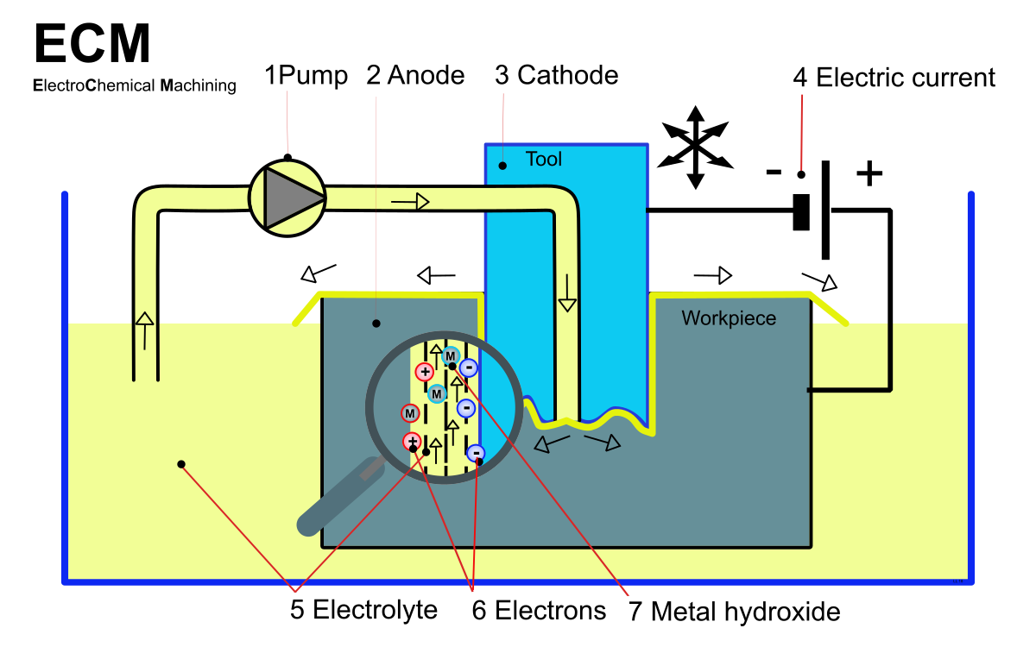
introduction
Electro Chemical Machining is a non-conventional machining process.
It is used to machine difficult to cut materials and it is reverse of electro plating
Important elements of ECM are:
Electrolyte
Tool
Workpiece
DC power source
Fig 1: Schematic of ECM process

Slide 4
Why electro-chemical MACHINING
Limitations of other machining processes | Advantages of ECM
Tool availability and design Tool distortions and tool wear Development of mechanical or residual stresses Heat affected zones and presence of recast layers. Some processes depends on hardness of workpiece material Low machining efficiency Expensive and tedious process | No tool wear or tool distortions Burr free surface Residual stresses are not present Thermal damages due to Heat affected zones are absent Machining of thermally sensitive materials Better accuracy and good surface finish MRR is independent of workpiece materials.

Slide 5
Why ultrasonic vibrations
Ultrasonic corresponds to a physical wave that propagates at frequencies of more than 20khz
Ultrasonic vibration can be transmitted through solid-phase or liquid-phase materials with any properties.
There is periodic change in Inter electrode gap which improves the machining and flushing of removed particles.
Ultrasonic vibration can reduce the machining force through intermittent cutting between machine tools and the workpiece.
it can produce parts with high precision that are made of hard and brittle materials which are often difficult to machine.
Ultrasonic machining is able to produce high-tolerance parts because there is no distortion of the worked material, this is due to no heat generation.

Slide 6
Literature review (state of art)
Authors | Findings and outcomes
Wang et al [1] | Modified jet-ECM to fabricate deeper grooves for milling micro using a tube electrode An Insulating layer and jet shape adjustment was used to reduce stray corrosion at the micro-groove edge. A blind groove with a radius of 1.5mm and depth 1.2mm was machined in Al sheet.
Chen et al [2] | Effect of voltage, pulse on time and pulse frequency on the machining performances, MRR and groove accuracies in micro ECM Voltage and pulse on time has significant impact on corner radius and the taper between the sidewall of a groove. Better geometrical accuracy, at low voltage and short pulse on-time.

Slide 7
Literature review (pulse dc and UV assisted)
Authors | Findings and outcomes
Mithu et al [3] | Investigated effect of applied frequency pulses on shape and size of fabricated micro holes, machining time and MRR for various types of micro tools. Short pulse-on voltage with long pulse-off time is preferred in order to improve accuracy and surface finish. It improve the localization of dissolution to sub-micrometer
Heiwdy et al. [4] | Developed a Ultrasonic vibration assisted pulse electrochemical micromachining process for generating complex micro-components of high accuracy. A mathematical model has been developed and the effect of voltage and feed rate on process performance has been studied. From the result a higher pulse frequency (1 MHz) indicated smaller side and frontal gaps with sharper edges than the results at 250 KHz.

Slide 8
Literature review
(Contd.)
Authors | Findings and outcomes
Goel et al [5] | Experiments were conducted to obtain second order model using Central composite rotatable design (CCRD). It was observed that MRR improved with a rise in pulse on time of ultrasonic vibrations. The hole taper decreased with the rise in pulse on time. It was concluded that combining ultrasonic vibrations with the Jet-ECMD resulted in an enhancement of the process.
Madhan et al [6] | The comparison of Austenitic nickel chromium based super alloys - Inconel 625 and Inconel 718 from output response MRR in Micro ECM was done. Regression analysis and ANOVA were done on the experimental results. Inconel 625 alloy had faster machining rate compared to Inconel718 alloy and it was also concluded that the MRR of alloy increases with nickel content.

Slide 9
objectives
To formulate analytical model towards calculation of MRR and overcut in electro jet drilling under the application of ultrasonic vibration to the workpiece and feed rate to the tool.
To investigate the effect of pulsed power supply and application of ultrasonic vibrations in Electro-jet drilling.
To study the effect of the process parameters like pulse frequency, Duty cycle, and Ultrasonic vibration frequency on machining performance (MRR, hole diameter and overcut)
Optimization of the process through regression analysis using Response Surface Methodology.

Slide 10
* Formulating analytical model for calculating MRR including the overcut.
* A code to solve the equation for MRR was written by using MATLAB.
* Assembling of the equipment, Ultrasonic generator & transducers existing setup.
* Pulse generator was used to give the required Pulse DC input.
* Process demonstration & to carry out detailed experimentation to study the …. . effect of process parameters on cut quality.
* The design of the experiments was done in Design Experts using RSM.
* Regression analysis was done on Aluminum and Inconel sheets to predict the effects of Pulse frequency, duty cycle and ultrasonic vibration frequency on MRR, Overcut and Hole diameter.
METHODOLOGY

Slide 11
Analytical model (Nomenclature)
E: Electro chemical equivalence (a / z) | k: Electrolyte conductivity (k = 1/r )
W: Mass of material removed | r: Resistivity
Q: Charge applied | η: Machining efficiency
𝑉_{𝑚}: Volume of material removed | F: Faraday’s constant (96,500 C)
I: Current | 𝜌_{𝑚}: Density of work piece material (g/mm3)
𝑉₀: Applied potential | a: Vibration amplitude (mm)
A: Machined area | ω: Angular velocity (rad/s) = 2πf
a : Atomic weight | f: Vibration frequency (Hz)
z: Valency | t: Time (sec)
h: Equilibrium gap (mm) | ϕ: Phase angle (rad)
C: Constant | E: Electrochemical equivalent

Slide 12
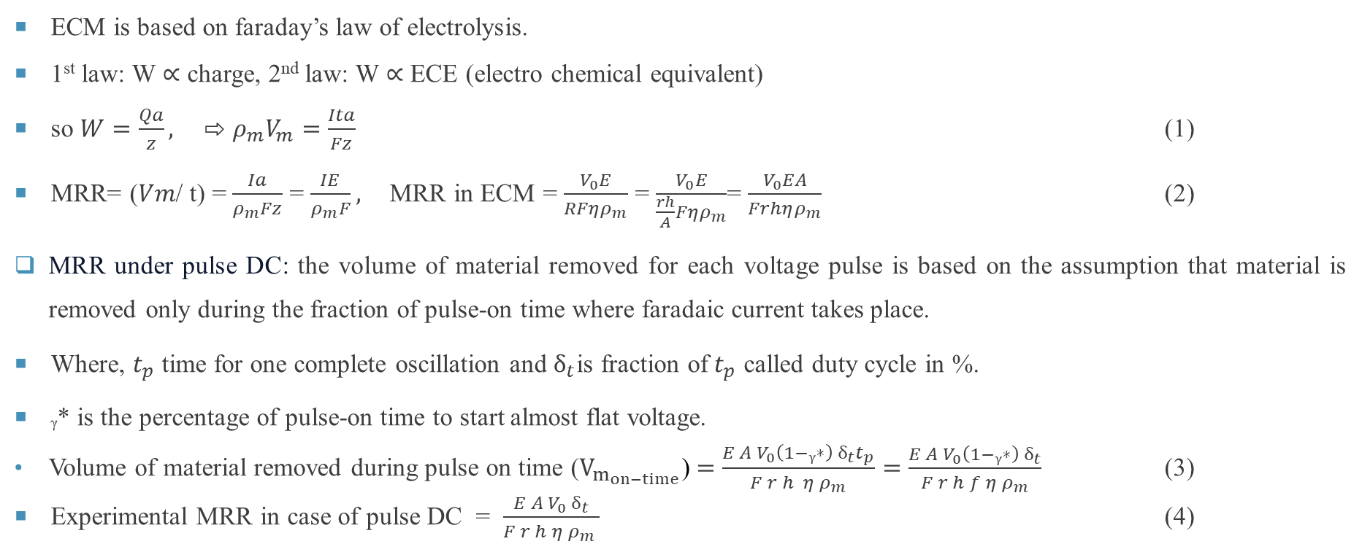
Analytical model
ECM is based on faraday’s law of electrolysis.
1st law: W ∝ charge, 2nd law: W ∝ ECE (electro chemical equivalent)
so $W=\frac{Qa}{z},$ ⇨ $ρ_{m}V_{m}=\frac{Ita}{Fz}$ (1)
MRR= (𝑉𝑚/ t) = $\frac{Ia}{ρ_{m}Fz}$ = $\frac{IE}{ρ_{m}F},$MRR in ECM = $\frac{V_{0}E}{RFηρ_{m}}$ = $\frac{V_{0}E}{\frac{rh}{A}Fηρ_{m}}$= $\frac{V_{0}EA}{Frhηρ_{m}}$ (2)
MRR under pulse DC: the volume of material removed for each voltage pulse is based on the assumption that material is removed only during the fraction of pulse-on time where faradaic current takes place.
Where, $t_{p}$ time for one complete oscillation and $ẟ_{t}$is fraction of$t_{p}$ called duty cycle in %.
ᵧ* is the percentage of pulse-on time to start almost flat voltage.
Volume of material removed during pulse on time ($V_{m_{on−time}}$) $=\frac{E A V_{0}\left(1−ᵧ∗\right) ẟ_{t}t_{p}}{F r h {η ρ}_{m}}=\frac{E A V_{0}\left(1−ᵧ∗\right) ẟ_{t}}{F r h f {η ρ}_{m}}$ (3)
Experimental MRR in case of pulse DC = $\frac{E A V_{0} ẟ_{t}}{F r h {η ρ}_{m} }$ (4)

Slide 13
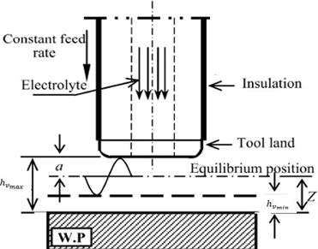
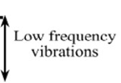
Analytical model
MRR under ultrasonic vibration in EJMM:
Displacement equation is X (t) = a sin (ω t + ϕ) where ω = 2πf (5)
Velocity equation is Ẋ(t) = a ω cos (ω t+ ϕ)
(𝑓_{𝑣}) = s ± a ω cos (ω t + ϕ), (where s is the initial feed rate) (6)
So, the frontal gap due to vibration will be ℎ𝑣= Z ± a sin (ω t + ϕ)
MRR (ultrasonic vibration) (𝑀𝑅𝑅𝑉) = (𝑘 𝑉𝑜 𝐸 𝐴 𝜂) / (𝜌𝑚𝐹 [Z ± 𝑎 sin (ω t + ϕ)])
(𝑀𝑅𝑅𝑉) = (𝑘 𝑉𝑜 𝐸 𝐴 𝜂) / (𝜌𝑚𝐹 [hc ± 𝑎 sin (ω t + ϕ)]) (7)
hc = c/s = ( 𝑉𝑜 Mx) / (𝜌𝑚𝐹r), here hc is the constant gap.
S is the feed rate given to tool for keeping the electrode gap constant.
Fig. Tool–work piece configuration
during ECM with tool vibration
Reference from [2]

Slide 14
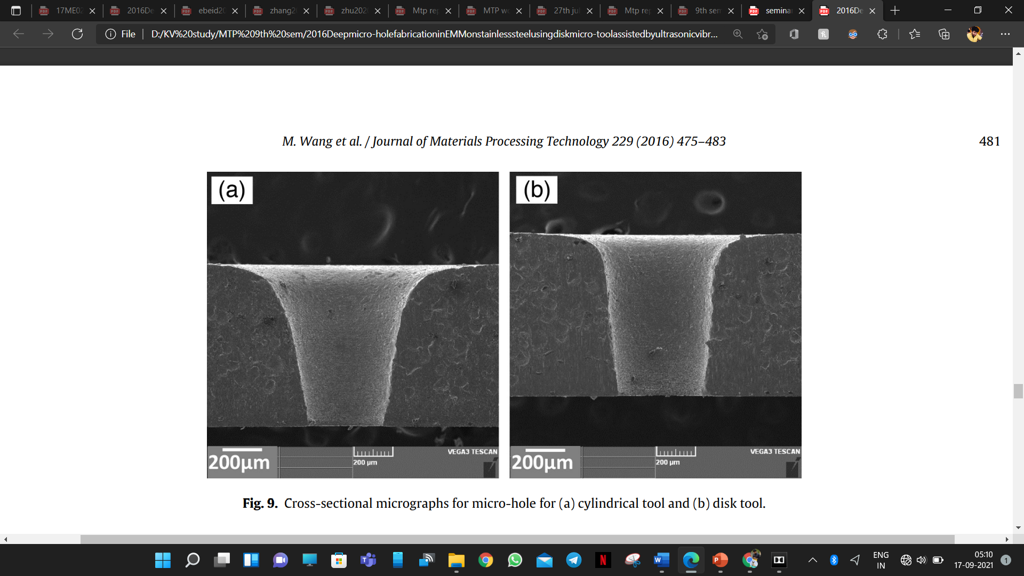
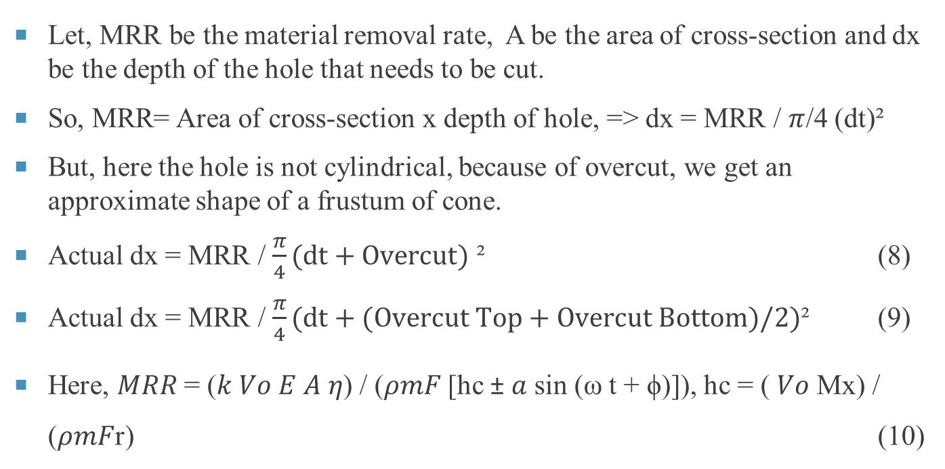
Analytical model (Overcut calculation)
Let, MRR be the material removal rate, A be the area of cross-section and dx be the depth of the hole that needs to be cut.
So, MRR= Area of cross-section x depth of hole, => dx = MRR / $π$/4 (dt)²
But, here the hole is not cylindrical, because of overcut, we get an approximate shape of a frustum of cone.
Actual dx = MRR / $\frac{π}{4}(dt+Overcut)$ ² (8)
Actual dx = MRR / $\frac{π}{4}(dt+(Overcut Top+Overcut Bottom)/2)$² (9)
Here, 𝑀𝑅𝑅 = (𝑘 𝑉𝑜 𝐸 𝐴 𝜂) / (𝜌𝑚𝐹 [hc ± 𝑎 sin (ω t + ϕ)]), hc = ( 𝑉𝑜 Mx) / (𝜌𝑚𝐹r) (10)
Fig: overcut in drilled holes [1]

Slide 15
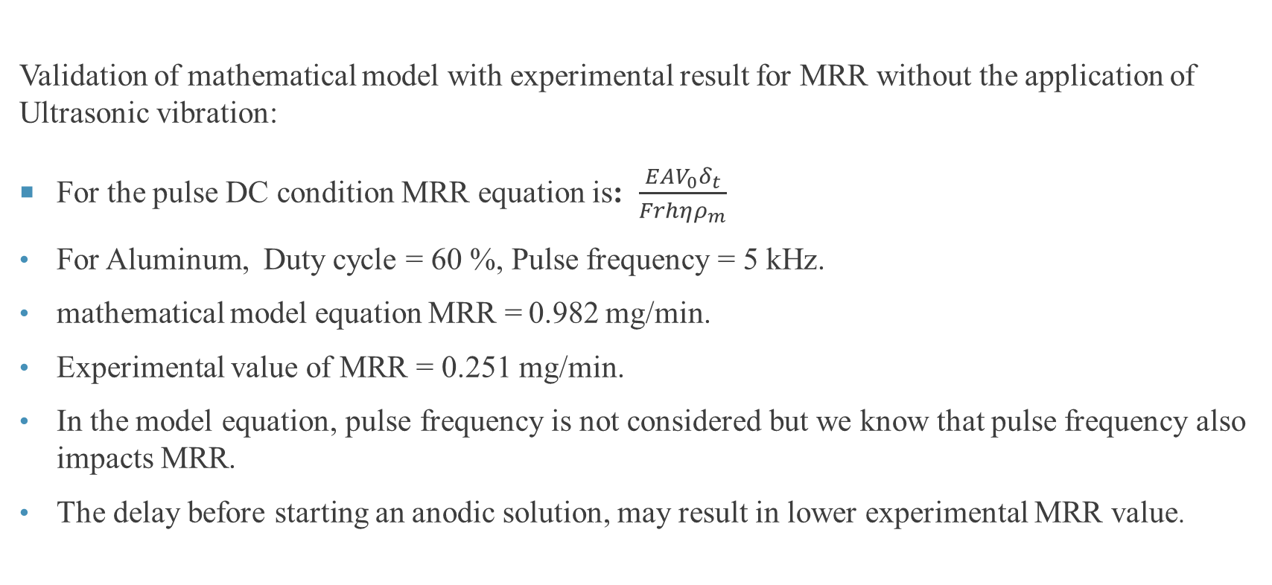
Validation of the Model equation of MRR
Validation of mathematical model with experimental result for MRR without the application of Ultrasonic vibration:
For the pulse DC condition MRR equation is: $\frac{EAV_{0}δ_{t}}{Frhηρ_{m}}$
For Aluminum, Duty cycle = 60 %, Pulse frequency = 5 kHz.
mathematical model equation MRR = 0.982 mg/min.
Experimental value of MRR = 0.251 mg/min.
In the model equation, pulse frequency is not considered but we know that pulse frequency also impacts MRR.
The delay before starting an anodic solution, may result in lower experimental MRR value.

Slide 16
Experimental setup
The setup comprises of four main systems
Power supply system
Tool Assembly
Workpiece movement control system
Electrolyte circulation system
Fig : Schematic of Electro Chemical Turning

Slide 17

Experimental setup (POWER SUPPLY SYSTEM)
DC power supply:
Workpiece : positive terminal
Tool : negative terminal
Both continuous and pulse DC power supply were used in the experiments
The specifications of both the power sources is given in the table .
a.
Fig : a) Continuous DC power supply, b) Pulse generator for pulse DC power source
Table : Specifications of the power sources
continuous DC power supply |  | pulse DC power supply
Voltage | 20V | Voltage | 20 V
IEG | 0.2 mm | Pulse frequency | 0.5 Hz to 50 kHz
Current | 0.1-0.3 A | Duty cycle | 40-80%
 |  | IEG | 0.2 mm

Slide 18
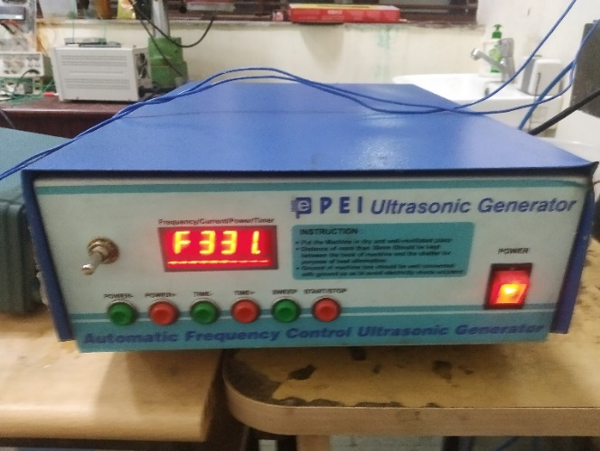
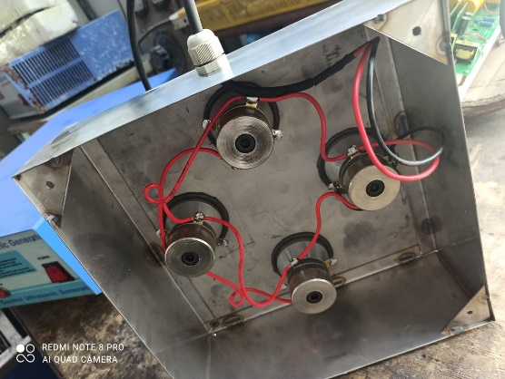
Experimental setup (UV Setup)
Ultrasonic generator:
Ultrasonic generator is used for generating vibration in the transducers which were placed in a stainless-steel box.
Frequency of vibration was controlled by ultrasonic generator.
Frequency range lies between 28-34 kHz
Ultrasonic transducers:
Four ultrasonic transducers are placed inside a SS box and
On the top of this workpiece is placed inside machining tank, the workpiece is held with the help of workpiece holder.
Fig: Ultrasonic generator
Fig: transducers mounted inside SS box

Slide 19
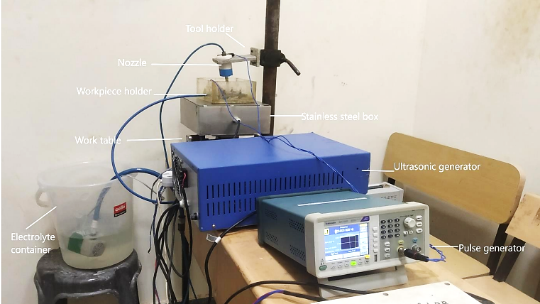
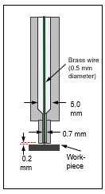
Complete Experimental setup
Fig: Complete Experimental Setup
Fig: Nozzle design

Slide 20
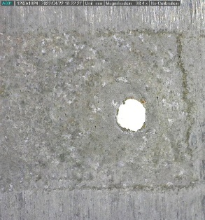
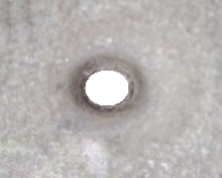
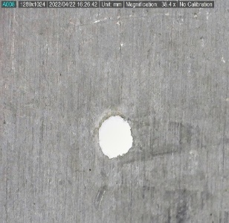

Experimental results
Aluminium sheet | Inconel sheet
(a) Top view | (c) Top view
(b) Bottom view | (d) Bottom view
Aluminium sheet thickness | 0.5mm
Inconel sheet thickness | 0.5mm
Pulse frequency | 5 kHz
Duty cycle | 60 %
Ultrasonic vibration frequency | 28 kHz
Inter Electrode gap | 0.2 mm
Electrolyte conc. | 30 gm/litre
1mm
1mm
1mm
1mm
Fig. top and bottom drilled samples of Aluminum sheet Inconel sheet
Fig: Process parameters

Slide 21
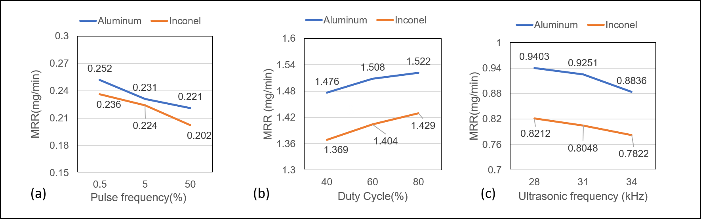
EFFECT ON INDIVIDUAL PARAMETERS ON MRR
Fig: Effects of the individual parameters on the MRR
With increase in pulse frequency, the time for anodic dissolution decreases, which causes a reduction in MRR
As duty cycle increases, percentage of pulse on-time increases and more pulse on time means more MRR
With an increase in vibration frequency, amplitude of vibration decreases, so MRR eventually decreases
Aluminium has higher tendency than Inconel to form ions and thus Al comes out much easily in ECM process.

Slide 22
Experimental vs theoretical % change in mrr
Table. Comparing the Experimental and theoretical change in MRR for Aluminum and Inconel.
Pulse Frequency | Duty Cycle | Experimental MRR (Al) | Experimental MRR (Inconel) | Experimental % change | Theoretical% change
0.5 | 80 | 0.271 | 0.246 | 9.2 | 8.6
0.5 | 60 | 0.246 | 0.224 | 8.1 | 7.5
50 | 40 | 0.191 | 0.176 | 7.8 | 8.2
50 | 60 | 0.212 | 0.197 | 7.1 | 7.6
All the theoretical values are calculated using the equation of MRR in Pulsed DC voltage
The theoretical percentage change and the experimental percentage change of MRR in case of Inconel and Aluminium followed a similar trend.

Slide 23
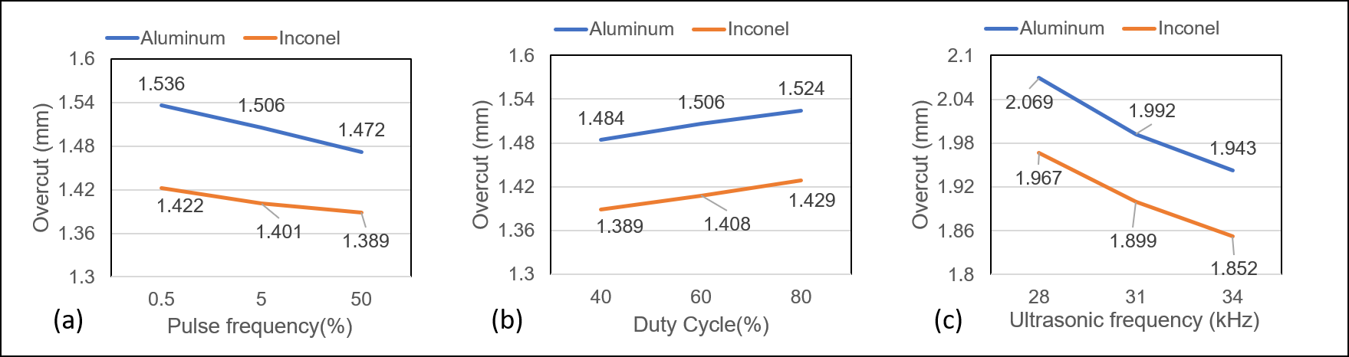
Effect on individual parameters on Overcut
EFFECT ON INDIVIDUAL PARAMETERS ON OVERCUT
Fig. Effect of individual parameters on Overcut
At lower frequency pulse duration is long so top surface is exposed for a longer time so more is the overcut at lower pulse frequency.
Overcut increases with increase in the Duty cycle because of higher pulse energy (high pulse on time)
The increase in ultrasonic frequency, decreases the amplitude of vibration and the hole diameter decreases so overcut also decreases.

Slide 24
Optimisation through RSM
Identification of problem
Determination of the dependent variables (responses)
Determination of the independent variable
Screening experiments
Decision of Factor levels
BBD, CCD, CCRD etc.
Selection of proper design
ANOVA test to check the fitness of the model
Evaluation of the model
Running Experiment

Slide 25
Optimisation using RSM
Optimization by Response Surface methodology was done
first statistically designed the experiments, then the estimate of the coefficients are put in a mathematical model and finally predicting the response and checking the adequacy of the model within.
Box-Behnken designs are used to generate higher order response surfaces using fewer runs than a normal factorial technique. Analysis is done using ANOVA.
Table2: Levels of selected Input Variables for both the materials.
FACTORS | Units | Level -1 | Level +1
Pulse Frequency | kHz | 0.5 | 50
Duty Cycle | % | 40 | 80
Ultrasonic Frequency | khz | 28 | 34

Slide 26
Analysis of variance
Table2: Abstracted ANOVA table for all responses
Material | Response | Significant terms | P-value | Lack of Fit | R² | Adj-R² | Pre-R² | Adequate Precision
Aluminium | MRR | A, B, C, AB, AC , BC, A², B², C² | <0.0001 | Not sig | 0.9967 | 0.9924 | 0.9771 | 50.68
 | Hole Dia | A, B, C, AC , BC, A², C² | <0.0001 | Not sig | 0.9793 | 0.9632 | 0.8925 | 25.70
 | Overcut | A, B, C, AC , BC, A², C² | <0.0001 | Not sig | 0.9810 | 0.9663 | 0.9240 | 25.75
Inconel | MRR | A, B, C, AB, AC , BC, A², B², C² | <0.001 | Not sig | 0.9938 | 0.9858 | 0.9443 | 36.98
 | Hole Dia | A, B, C, AB, AC , BC, A², B², C² | <0.001 | Not sig | 0.9993 | 0.9984 | 0.9901 | 55.25
 | Overcut | A, B, C, AC, A², C² | <0.001 | Not sig | 0.9716 | 0.9546 | 0.9051 | 23.17
Model significance test and lack of fit test were carried out.
A step wise regression method was selected to find out the significant model terms.
The resultant ANOVA tables for reduced quadratic model summarizing the analysis of variance for each response.

Slide 27
Regression model (aluminium)
Analysis of variance of all the three output quality parameters has been studied for Aluminium sheet and Regression analysis has been performed. The final regression models in terms of actual factors are given by
MRR = 0.715293 + 0.000191*A + 0.001639*B – 0.033366*C – 0.000465*AB – 0.00090*AC + 0.000461*BC + 0.00053*A² + 0.00021*B² +0.000469*C² (1)
Hole Diameter = 6.05609 – 0.008005*A – 0.006152*B – 0.262558*C – 0.000312*AB + 0.000408*BC + 0.000326*A² + 0.003664*C² (2)
Overcut = 2.52525 – 0.000579*A + 0.0004246*B – 0.11228*C – 0.000019*AB – 0.000218*AC + 0.000151*A² + 0.001734*C² (3)
The above equations can be used to calculate the MRR, Hole diameter and Overcut by keeping the factors A (pulse frequency), B (duty cycle), C(Ultrasonic frequency) within the range.

Slide 28
Regression model (Inconel)
Analysis of variance of all the three output quality parameters has been studied for drilling in Inconel sheet and Regression analysis has been performed. The final regression models in terms of actual factors are given by
MRR = 0.513014 + 0.000132*A + 0.00054*B – 0.023115*C – 3.95597E-06*AB – 0.00058*AC + 0.000036*BC + 0.000034*A² – 5.12500E-0.6*B² + 0.000328*C² (1)
Hole Diameter = 4.58569 – 0.006818*A – 0.002699*B – 0.208778*C – 0.000035*AB – 0.000084*AC + 0.000233*BC + 0.000202*A² – 0.000026*B²+ 0.002981*C² (2)
Overcut = 2.43186 – 0.001914*A + 0.003963*B – 0.118089*C – 0.000218*AC + 0.000155*A² + 0.001827*C² (3)
The above equations can be used to calculate the MRR, Hole diameter and Overcut by keeping the factors A (pulse frequency), B (duty cycle), C(Ultrasonic frequency) within the range.

Slide 29
Validation of the model
For the Validation purpose of the model, points confirmation was done by using two different sets of parameters.
First set of parameters were taken from the optimised process parameters
A random process parameters within the range were considered for the second set.
The experimental results were compare to the Design of experiments results and the error is within the margin.
Material | Pulse freq. | Duty Cycle | UV freq. | MRR |  |  | Hole Diameter |  |  | Overcut
 |  |  |  | 95% Pi low | Exp | 95% Pi high | 95% Pi low | Exp | 95% Pi high | 95% Pi low | Exp | 95% Pi high
Aluminum | 15 | 75 | 31.4 | 0.2497 | 0.2524 | 0.2608 | 1.6772 | 1.7422 | 1.7989 | 0.8997 | 0.9341 | 0.9654
 | 10 | 70 | 30 | 0.2211 | 0.2261 | 0.2312 | 1.6531 | 1.7216 | 1.7987 | 0.8772 | 0.9156 | 0.9458
Inconel | 25 | 65 | 31.1 | 0.1899 | 0.1945 | 0.1989 | 1.4229 | 1.4921 | 1.5624 | 0.7208 | 0.7511 | 0.7894
 | 10 | 70 | 30 | 0.1945 | 0.1997 | 0.2045 | 1.4315 | 1.5016 | 1.5754 | 0.7311 | 0.7629 | 0.8012
Table : Validation runs for drilling on both aluminium and Inconel sheet

Slide 30
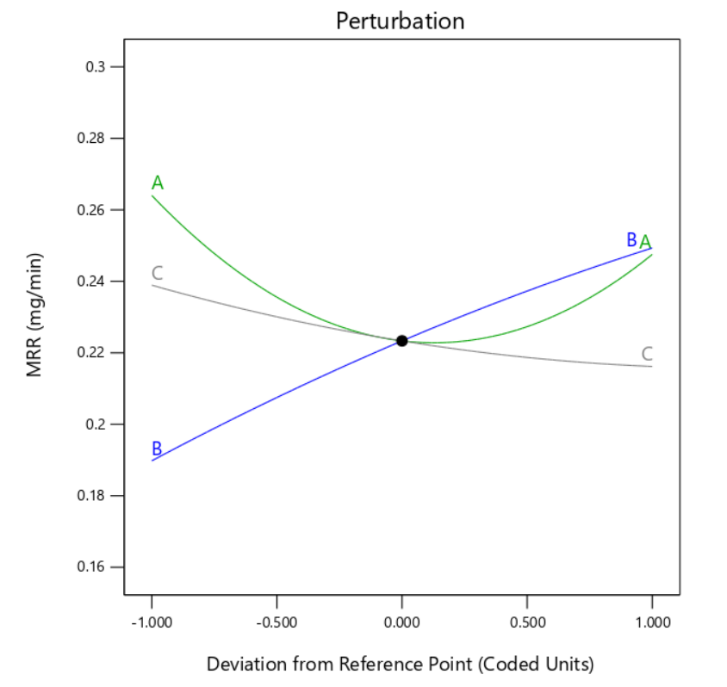
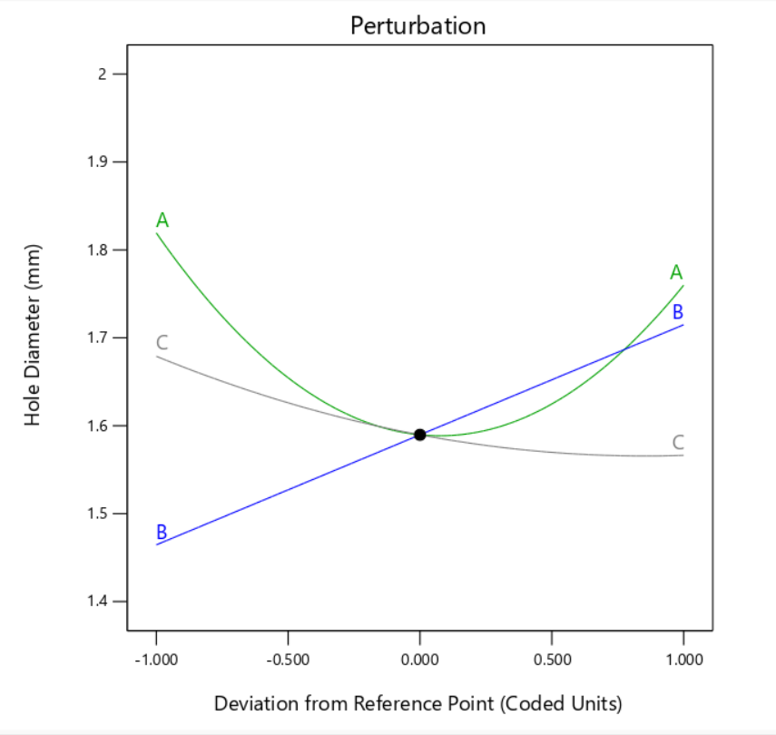
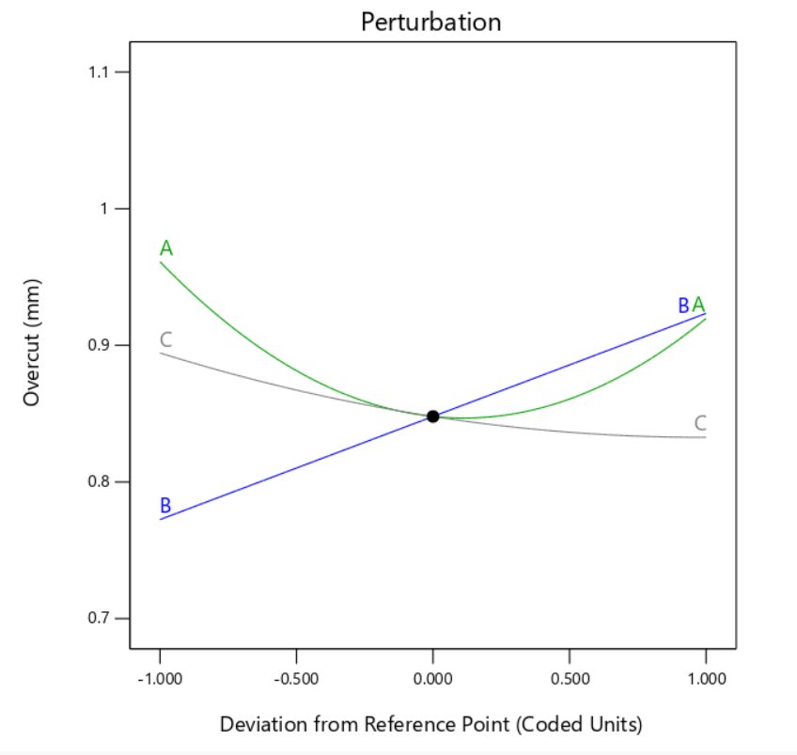
Perturbation plots of all responses against single factors
Fig: perturbation plot of MRR
Fig: perturbation plot of Hole diameter
Fig: perturbation plot of Overcut
A steep slope or curvature in a factor shows that the response is sensitive to that factor.
A relatively flat line shows insensitivity to change in that particular factor.
Graphs show that, both pulse frequency and duty cycle are most significant factors.
A relative flat line for Ultrasonic vibration frequency indicating its is not a much sensitive factor.
At higher pulse frequency, the Ultrasonic vibration frequency becomes a more significant factor.

Slide 31
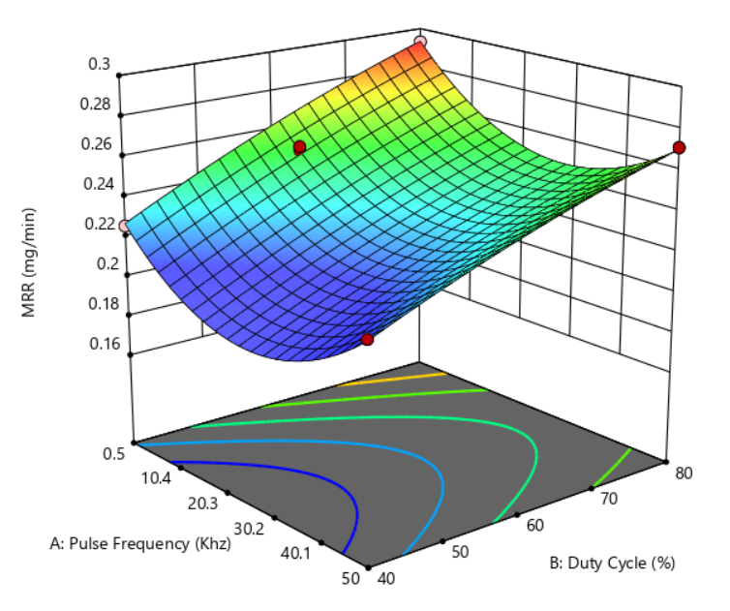
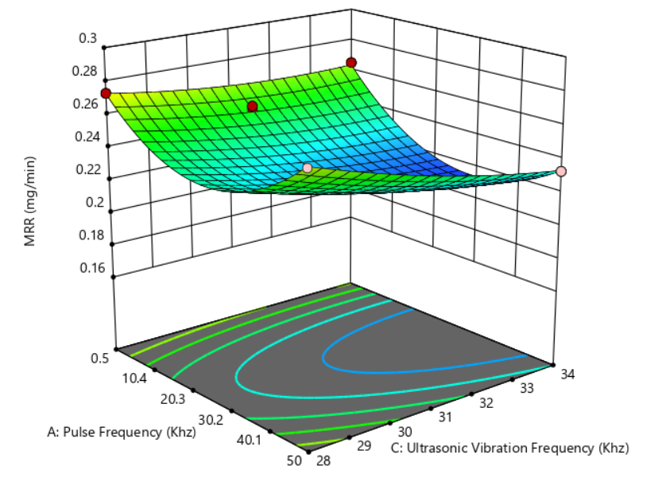
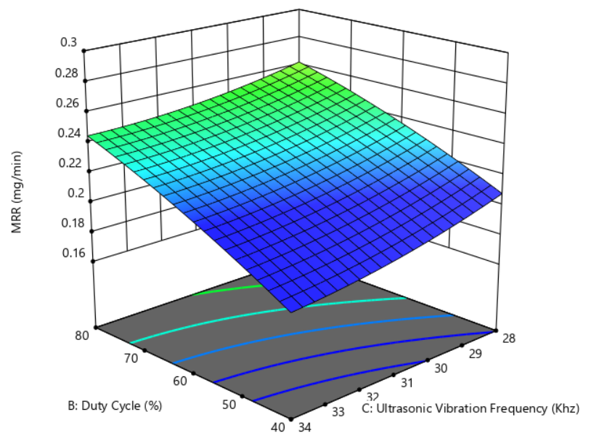
3-D Surface plot for MRR vs two factors for Aluminium sheet
Fig: Surface plot of MRR vs A & B
Fig: Surface plot of MRR vs A & C
Fig: Surface plot of MRR vs B & C
An increase in pulse frequency means for a less time, pulse current was applied. As time is less, less will be the material dissolution.
When workpiece subjected to ultrasonic vibration, IEG between electrodes changing in a periodic manner so there is slight improvement in MRR, due to vibration some trapped particles also gets removed.

Slide 32
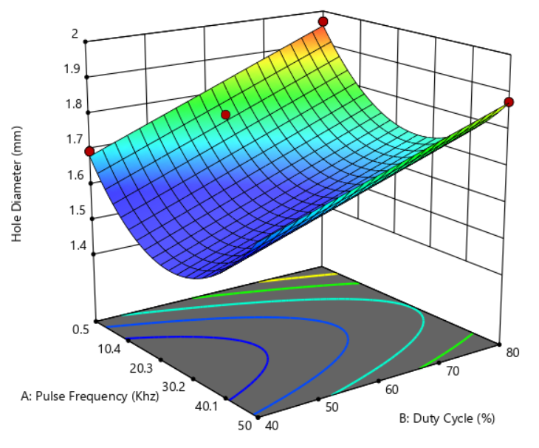
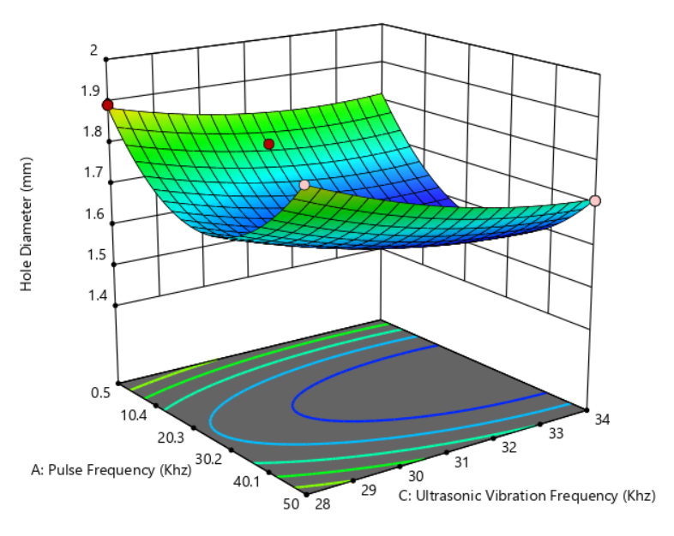
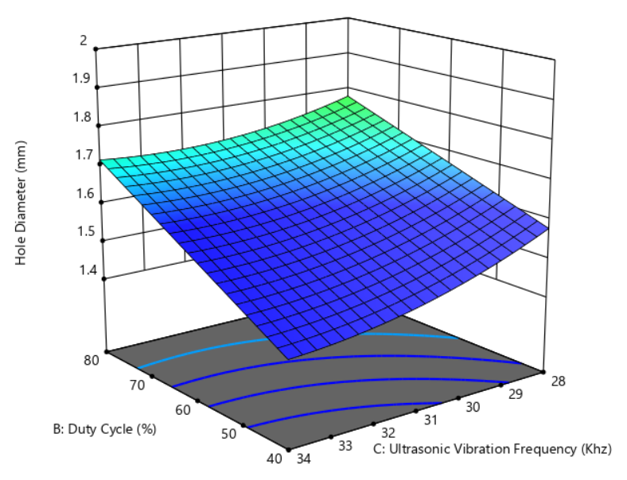
3-D Surface plot for Hole diameter vs two factors for Aluminium sheet
Fig: Surface plot of MRR vs A & B
Fig: Surface plot of MRR vs A & C
Fig: Surface plot of MRR vs B & C
The least hole diameter is for the combination of low duty cycle and high ultrasonic frequency.
At highest duty cyle and lowest frequency we get the highest hole diameter this is because MRR is higher for this combination and Hole diameter increases with MRR.

Slide 33
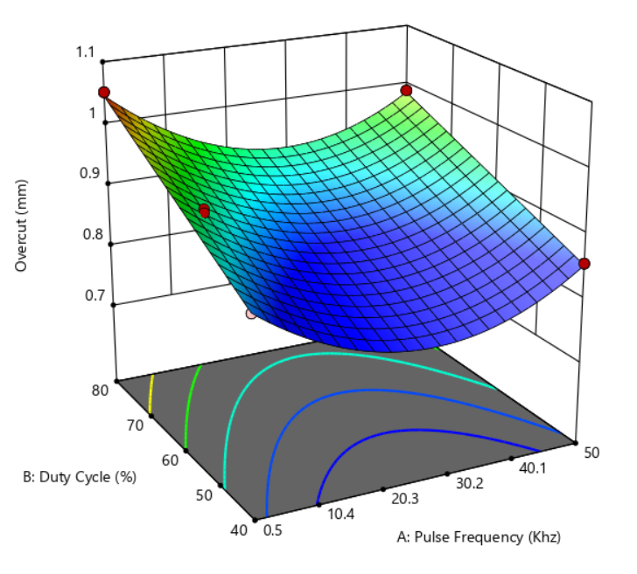
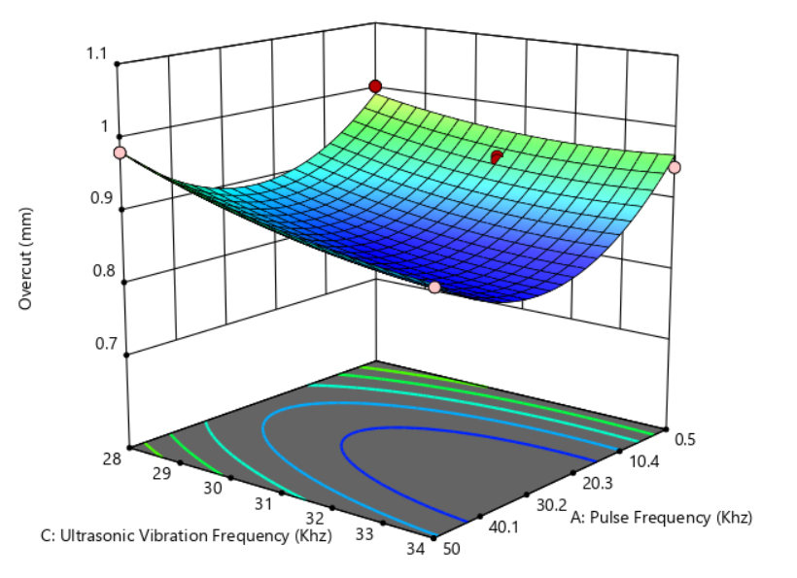
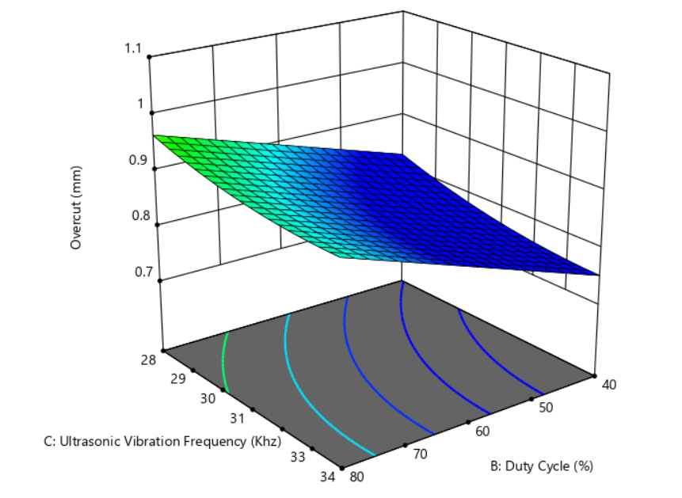
3-D Surface plot for Overcut vs two factors for Aluminium sheet
Fig: Surface plot of MRR vs A & B
Fig: Surface plot of MRR vs A & C
Fig: Surface plot of MRR vs B & C
At low pulse frequency due to higher pulse on time, more electric discharge is there and more sparking takes place, which results in improper cut and higher Overcut.
Increase in vibration frequency decreases the amplitude and eventually MRR decreases and the overcut also decreases but the trend is somewhat linear, means frequency of vibration has minimal effect.

Slide 34
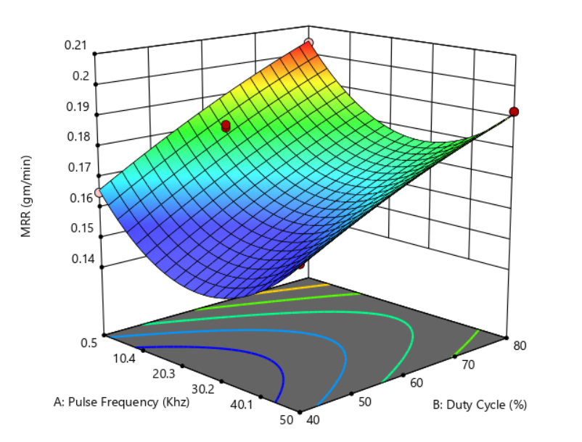
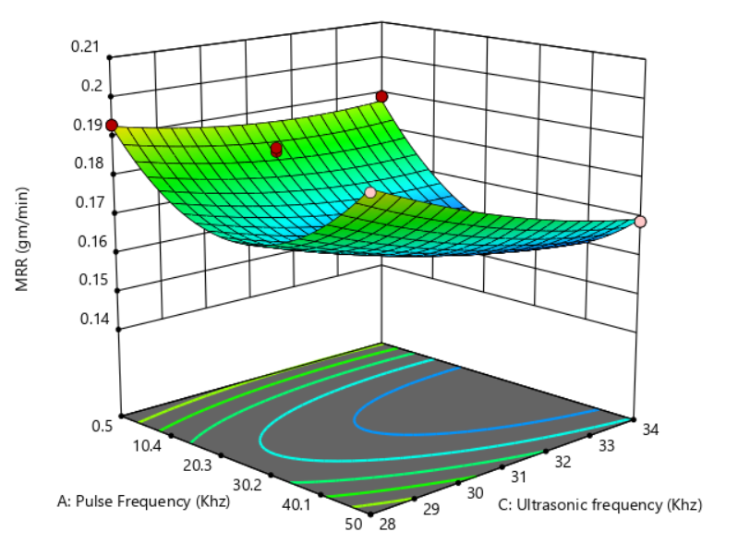
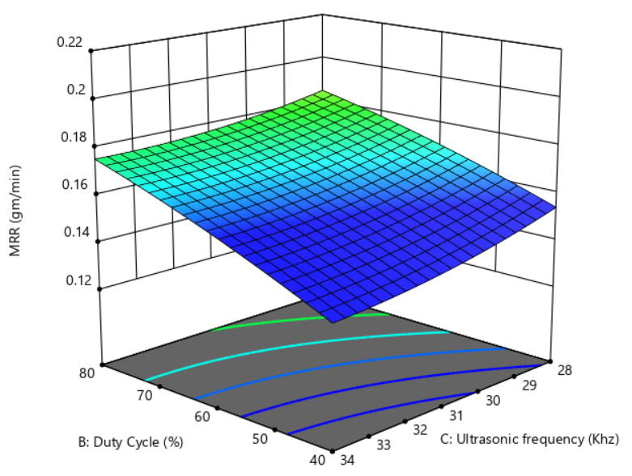
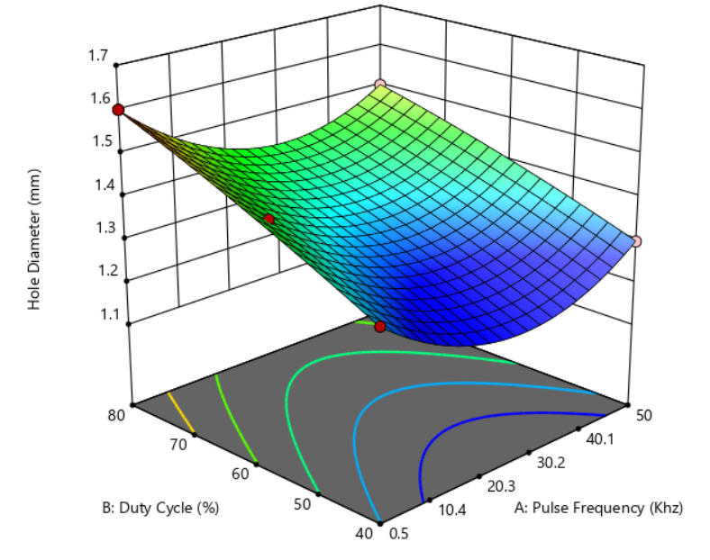
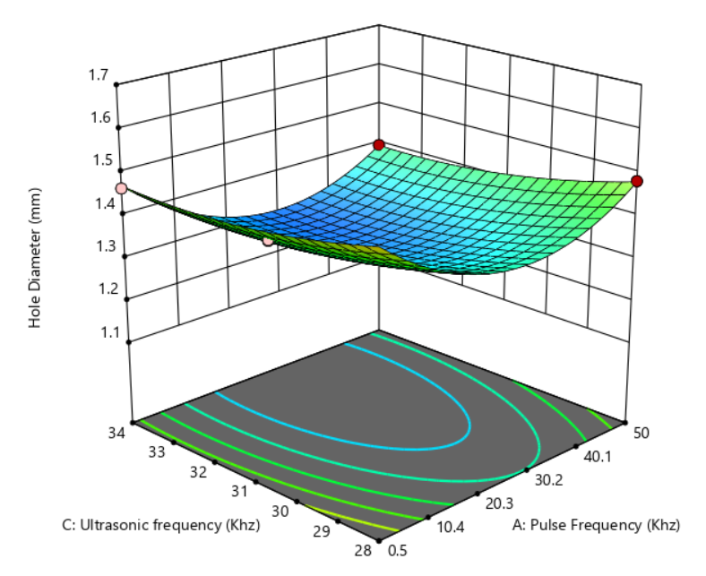
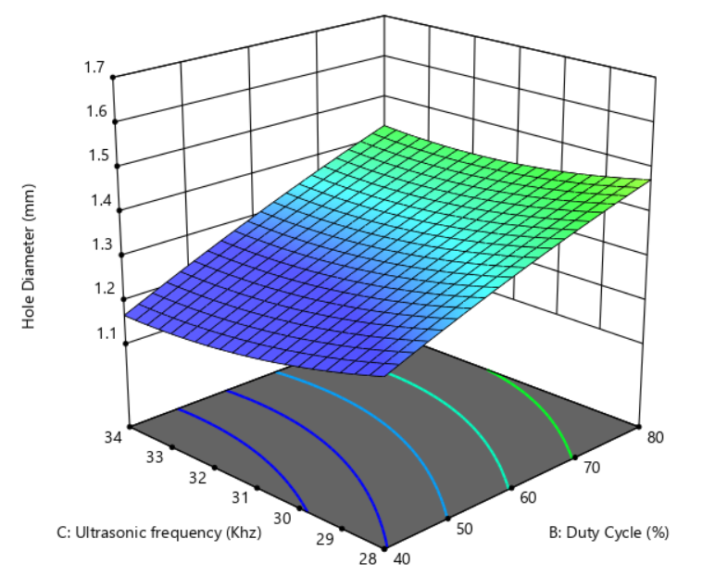
3-D Surface plot for all Responses vs two factors for Inconel sheet
Fig: Surface plot of MRR vs A & B
Fig: Surface plot of MRR vs A & C
Fig: Surface plot of MRR vs B & C
Fig: Surface plot of Hole dia vs A & B
Fig: Surface plot of Hole dia vs A & C
Fig: Surface plot of Hole dia vs B & C

Slide 35
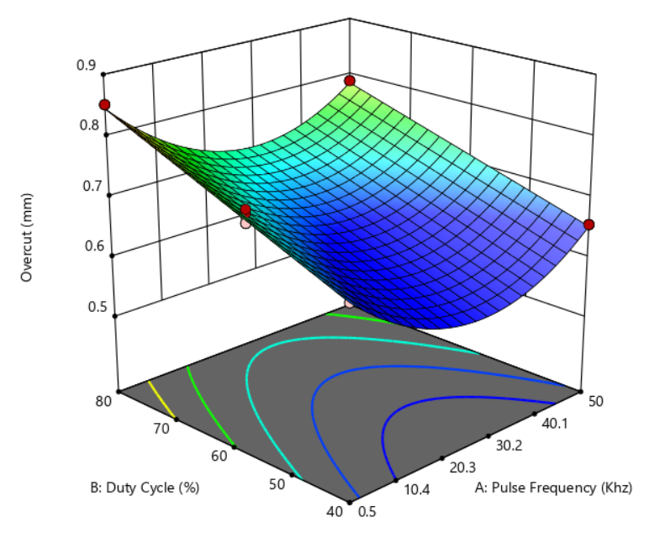
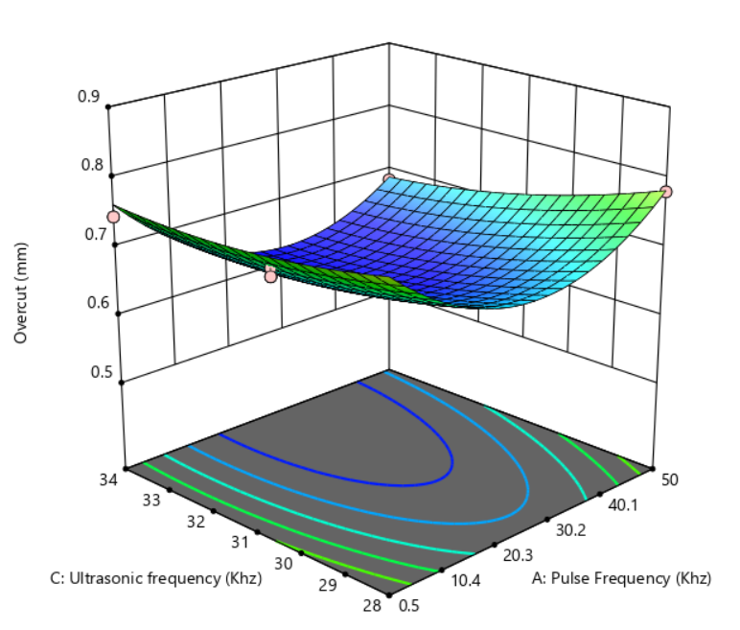
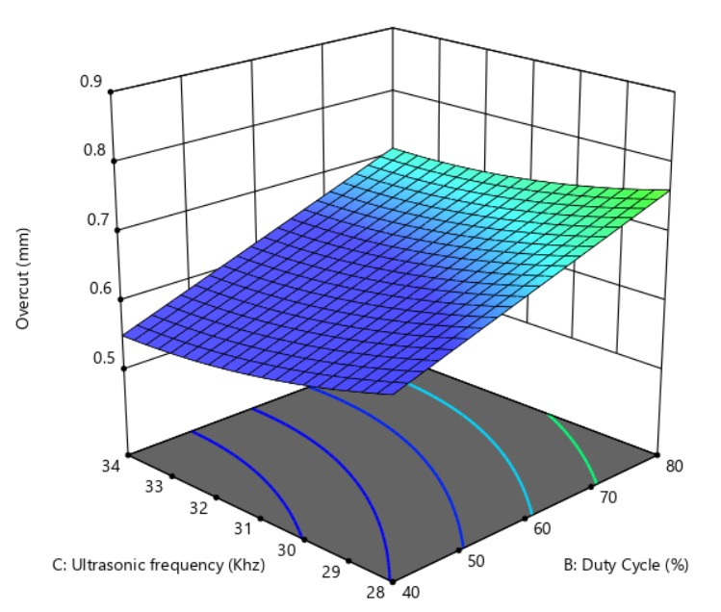
3-D Surface plot for all Responses vs two factors for Inconel sheet
Fig: Surface plot of Overcut vs A & B
Fig: Surface plot of Overcut vs A & B
Fig: Surface plot of Overcut vs A & B
The Inconel sheets follow a similar trend to that of Aluminium sheets.
We can observe that the range of MRR and Overcut are less in case of drilling in Inconel sheets as compared to Aluminum sheets

Slide 36
Optimisation of the model
Two main factors were considered while optimising
Maximising the MRR
Minimising the Overcut and hole diameter
Material | Condition | Pulse Frequency (kHz) | Duty Cycle (%) | Ultrasonic frequency (kHz) | MRR (mg/min) | Hole Diameter (mm) | Overcut (mm)
Aluminum | MRR max, Hole dia & Overcut min | 15 | 70 | 31.4 | 0.2542 | 1.7379 | 0.9337
Inconel | Hole dia & Overcut min | 30 | 60 | 32.5 | 0.2322 | 1.6298 | 0.8756
Inconel | MRR max, Hole dia & Overcut min | 25 | 65 | 31.1 | 0.1972 | 1.419 | 0.7311
 | Hole dia & Overcut min | 35 | 50 | 31.9 | 0.1763 | 1.3022 | 0.6598
Table : Optimum process parameters for maximizing MRR and Minimizing

Slide 37
conclusions
Higher pulse frequency and lower duty cycle results in the least amount of overcut and the lowest hole diameter, and as the Ultrasonic vibration frequency increases the hole diameter and the overcut decreases.
Higher duty cycle and a lower pulse frequency maximises MRR and as the U-V frequency increases the MRR increases, this may be due to better flushing and periodic IEG change in Ultrasonic vibrations case.
Holes drilled in Inconel sheets were found to have the lower amount of overcut and MRR as compared with holes drilled in Aluminium sheets.
Response Surface methodology has shown that Duty cycle has the significant role in machining as the duty cycle increases, the MRR and overcut keeps on increasing.
Material | Pulse frequency | Duty cycle | Ultrasonic frequency
Aluminium | 15 | 75 | 31.4
Inconel | 25 | 65 | 31.1
The optimum process parameters for Aluminium and Inconel are:

Slide 38
FUTURE WORK
Study the effect of the other process parameters like voltage, IEG, electrolyte concentration, feed rate on machining performances.
Modify the MRR equation for Ultrasonic vibration case or finding out the amplitude of vibration will give us theoretical value of MRR in case of constant feed to the tool.
Modifying the experimental setup so that we can give feed rates as small as 0.1mm/min to the tool while giving Ultrasonic vibrations to the workpiece.
Performing the same experiment on thicker sheets and observing the range of MRR, hole diameter and the overcut.

Slide 39
ACKNOWLEDGEMENT
I want to thank PIC of Workshop ,MTM , AM lab, Dr. MM Mahapatra , Dr . Suvradip mullick , Dr. Gaurav Bartarya , Dr. V Panduranga & Dr. Chetan for allowing me to use various kinds of consumables , equipments & ideas related to project.
I want to thank research scholar Mr. Shrey Bhatnagar, for his help and suggestion.
I want to thank Mr. Anindya Ankan Das for their coordination while doing the experiments.
I also want to thank Mr. P. K. Bisoi , Mr. A.K. Nayak , Mr S.K. Pradhan & Mr.Bibhudutta Mohanty and other technical staff of AM and MTM lab for their advice & help for doing this project successfully .
I also want to thank Mr. Virat singh (technical staff of Electrical Science Department) to guide & help through use of pulse generator in the experiments.

Slide 40
REFERENCES
Wang et al. Research on micro electrochemical milling. Key Eng. Mater. 375-376, 318–322.
Chen et al. Experimental research on electrochemical machining of titanium alloy Ti60 for a bilks Chinese Journal of Aeronautics. 2016 Feb 1; 29(1):274-282
Mithu et al. On how tool geometry, applied frequency and machining parameters influence Electro chemical micro-drilling. CIRP Journal of Manufacturing Science and Technology 5 (2012) 202–213.
Heiwdy et al. modelling the performance of ECM assisted by ultrasonic assisted vibrations, Journal of Materials Processing Technology 189 (2007) 466–472.
Goel et al. Experimental investigations into the ultrasonic assisted jet electrochemical micro-drilling process. Madhan et al. Investigations on austenitic nickel-chromium based super alloys - Inconel 625 and Inconel 718 from material removal rate in micro electrochemical machining. (2019) 345 – 349.

Slide 41
references
Zagorui et al. Effect of Applying an ultrasonic field on an electrolyte under electrochemical machining conditions, Elektronnaya Obrabotka Materialov (6) (1982) 7–9.
Bhattacharyya et.al. Modern machining technology Advanced, Hybrid, Micro Machining and Super Finishing Technology 2020, Pages 461-591.
Zhang.et al. Electro-chemical milling of narrow grooves with high aspect ratio using a tube electrode Journal of Materials Processing Tech. 282 (2020).
Kawanaka et al. Selective surface texturing using electrolyte jet machining. Procedia CIRP 13 (2014) 345 – 349.
Ming et al. Study on Kerosene Submerged Jet Electrolytic Micromachining. Procedia CIRP 68 (2018) 432 – 437.

Slide 42

Thank you

Slide 43
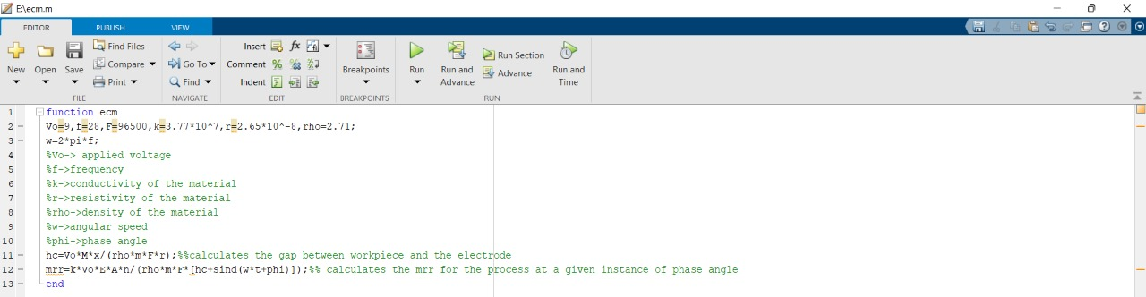
Analytical model (matlab)
The final analytical model equation is put in Matlab and the experimental results can be compared with the analytical result.

Slide 44
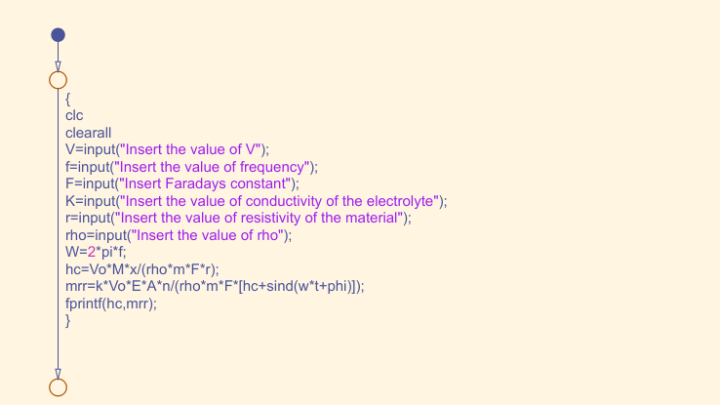
Analytical model
The final analytical model equation is put in Matlab and the experimental results can be compared with the analytical result.
Fig: Matlab flowchart

Slide 45
ANALYTICAL MODEL
At (ℎ𝑣𝑚𝑖𝑛), MRR will be maximum, MRR𝑣𝑚𝑎𝑥 = (𝑘 (𝑉𝑜 − 𝛥𝑉) 𝐸 𝐴) / (𝜂 𝜌𝑚𝐹 (ℎ𝑒 − 2𝑎))
At (ℎ𝑣𝑚ax), MRR will be m, MRR𝑣𝑚in = (𝑘 (𝑉𝑜 − 𝛥𝑉) 𝐸 𝐴) / (𝜂 𝜌𝑚𝐹 (ℎ𝑒))
In the above equation of MRR, if the inter electrode gap can be maintained constant by giving a constant feed rate to the workpiece.
Then the equation of MRR can be modified as, (𝑀𝑅𝑅𝑉) = (𝑘 𝑉𝑜 𝐸 𝐴 𝜂) / (𝜌𝑚𝐹 [hc ± 𝑎 sin (ω t + ϕ)])
hc = c/s = ( 𝑉𝑜 Mx) / (𝜌𝑚𝐹r)
Here, hc is the initial gap between the electrode and the workpiece, it will be maintained constant by giving the required feed rate ‘s’, which needs to be calculated experimentally.

Slide 46
Response surface methodology
The response surface methodology (RSM) is a widely used mathematical and statistical method for modeling and analyzing a process.
The experimental data are evaluated to fit a statistical model (Linear, Quadratic, Cubic or 2FI (two factor interaction)).
The coefficients of the model are represented by constant term, A, B and C (linear coefficients for independent variables), AB, AC and BC (interactive term coefficient), A², B² and C² (quadratic term coefficient).
Correlation coefficient (R²), adjusted determination coefficient (Adj-R²) and adequate precision are used to check the model adequacies; the model is adequate when its P value < 0.05.
Differences between means can be tested for statistical significance using analysis of variance (ANOVA)

